Slide 1
Nucleophilic Substitution

Slide 2
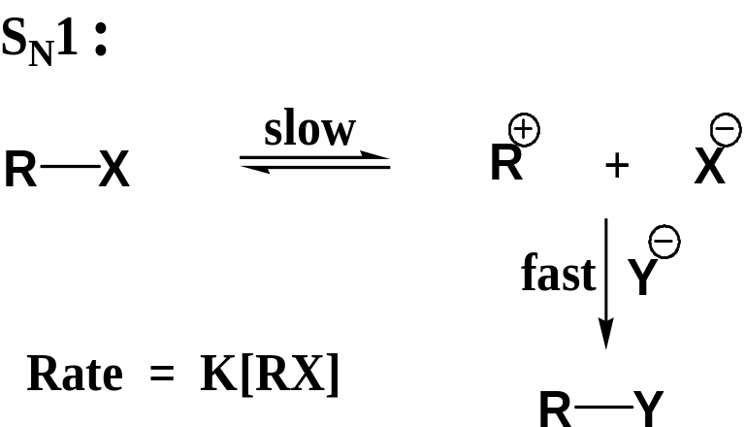
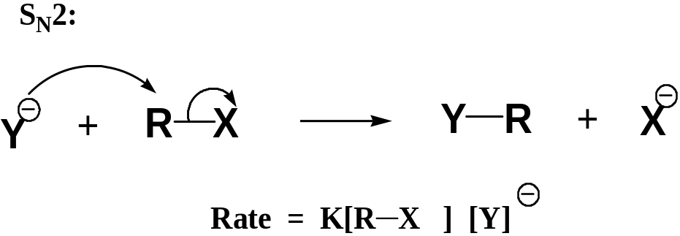
Two types of discrete mechanisms
S_{N}1
S_{N}2
S: Substitution
N: Nucleophilic
1: unimolecular
S: Substitution
N: Nucleophilic
2: Bimolecular

Slide 3
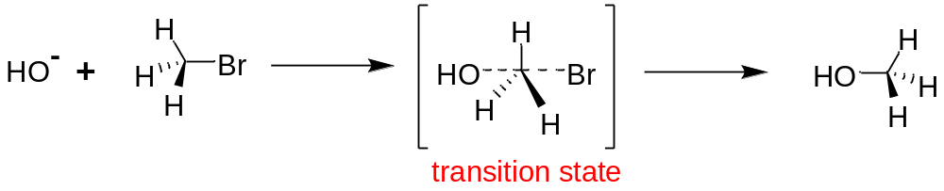
Hydrolysis of bromomethane in aqueous base proceeds according to
Rate = k₂[CH₃Br] [⁻OH]
S_{N}2
S_{N}2
Both alkyl bromide and ⁻OH are participating in the rate-limiting (slowest) step of the reaction.
⁻OH becomes partially attached to carbon before Br⁻ is fully detached.
Energy necessary for breaking C-Br bond is supplied by that produced in forming HO-C bond.
Quantum mechanical calculation shows that an approach by ⁻OH along the line of centers of the C & Br is that of lowest

Slide 4
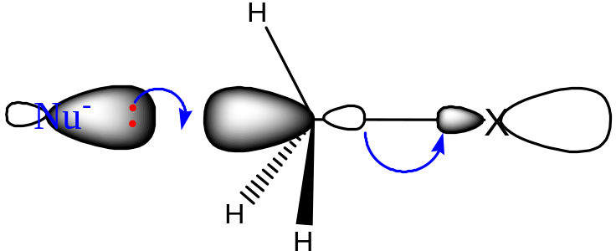
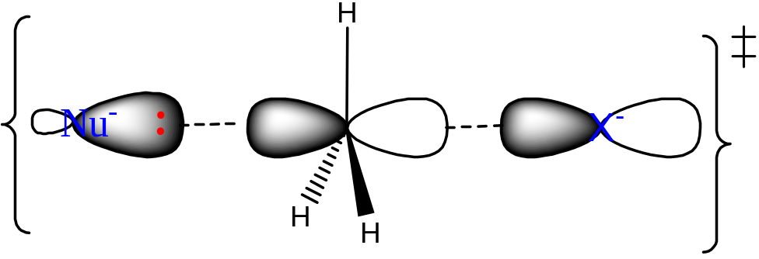
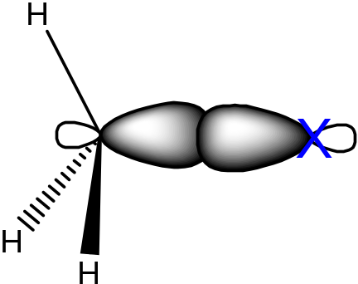
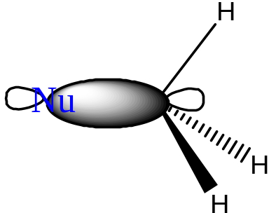
New σ bond being formed
old σ bond being broken
Filled orbital of Nu⁻
Emptyσ* orbital of C-X
P orbital of C-atom
Bonding orbital

Slide 5
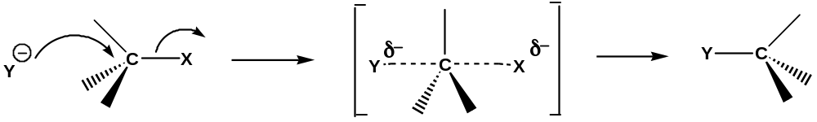
T.S. for S_{N}2
Inversion of configuration (Walden inversion)

Slide 6
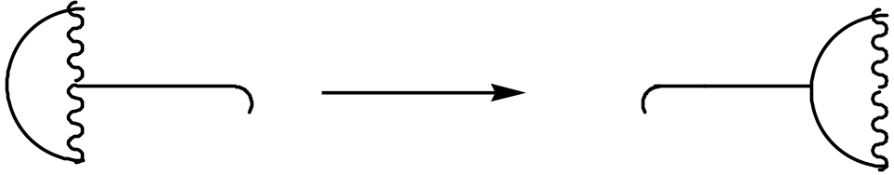
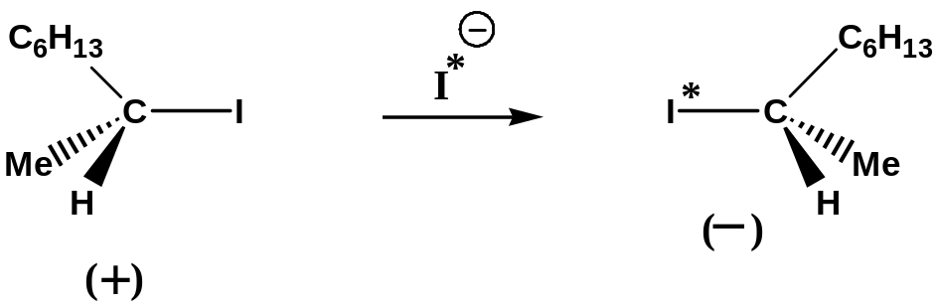
Important Point to Remember :
Inversion of configuration does not mean R going to S or vice versa.
It means that bond formation takes place opposite to that of bond
breaking….…..which leads to the inversion.
it is like inversion of umbrella in a storm.
Q.

Slide 7
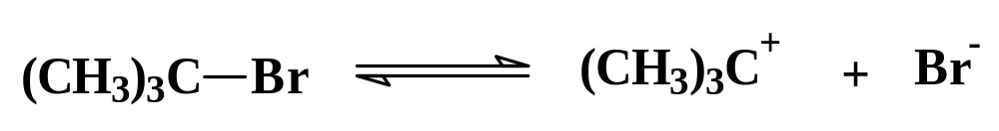
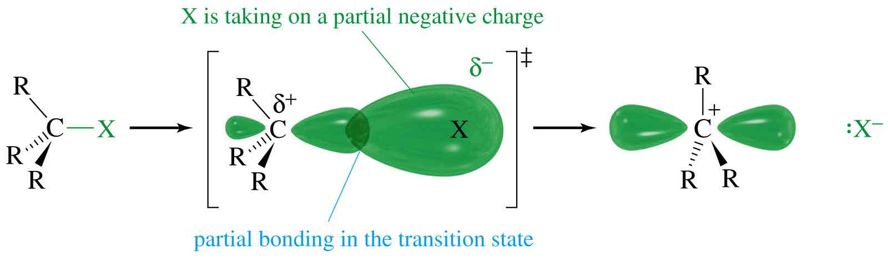
S_{N}1 Mechanism (1)
Formation of carbocation (slow)
=>

Slide 8
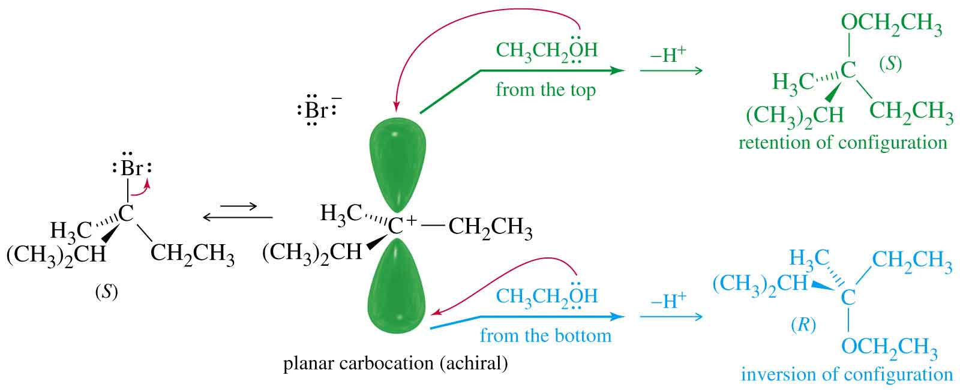
Stereochemistry of S_{N}1
Racemization:
inversion and retention
=>

Slide 9
Rearrangements
Carbocations can rearrange to form a more stable carbocation.
Hydride shift: H⁻ on adjacent carbon bonds with C⁺.
Methyl shift: CH₃⁻ moves from adjacent carbon if no H’s are available.
=>

Slide 10
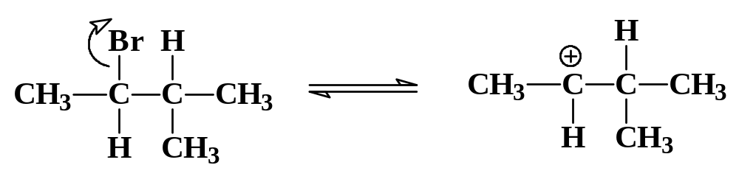
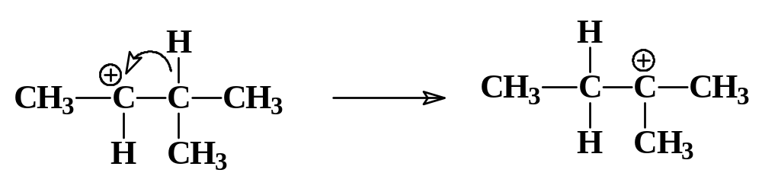
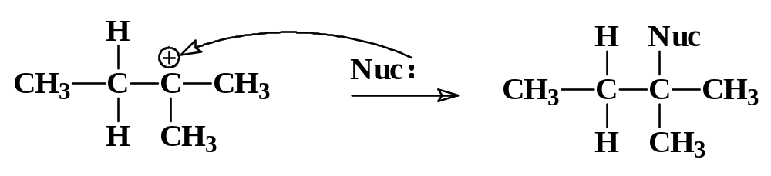
Hydride Shift
=>

Slide 11
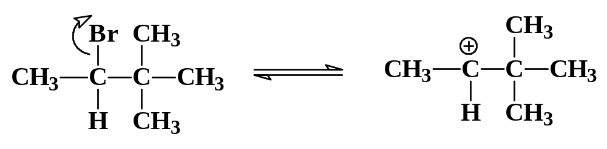
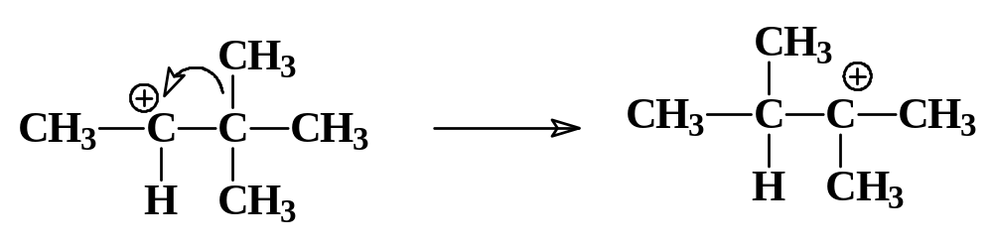
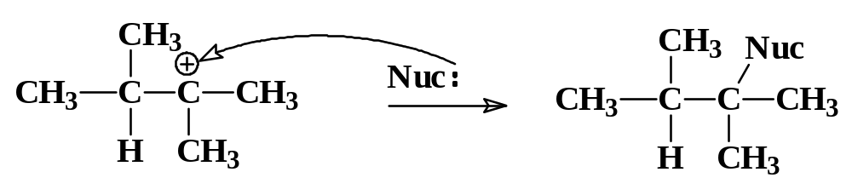
Methyl Shift
=>

Slide 12
S_{N}2 or S_{N}1?
Primary or methyl
Strong nucleophile
Polar aprotic solvent
Rate = k[halide][Nuc]
Inversion at chiral carbon
No rearrangements
Tertiary
Weak nucleophile (may also be solvent)
Polar protic solvent, silver salts
Rate = k[halide]
Racemization of optically active compound
Rearranged products =>

Slide 13
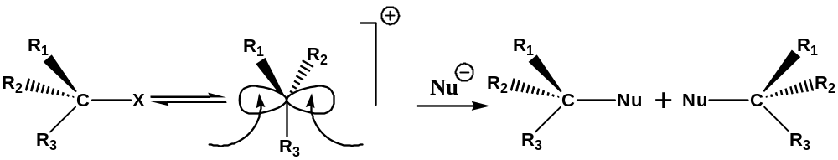
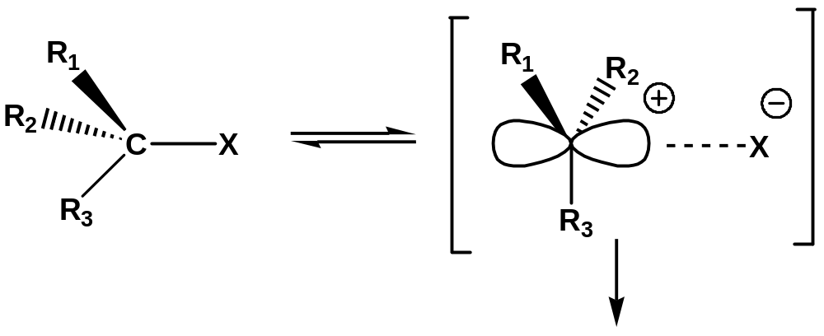
For S_{N}1 :
Racemization is expected
Extent of inversion = extent of retention
However, due to ion pair formation, more inversion then retention.
Ion pair mechanism :
More inversion than retention.

Slide 14
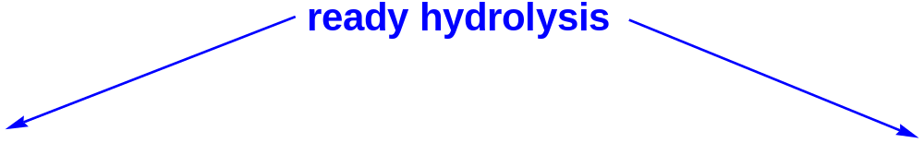
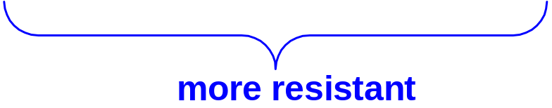
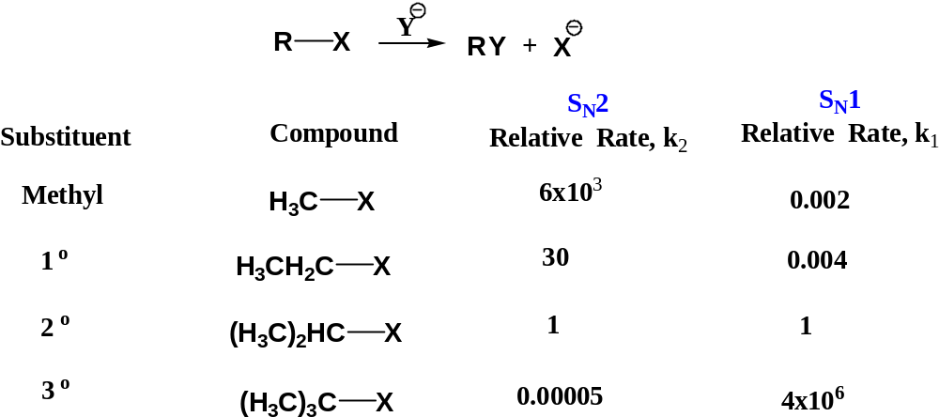
Effect of substrate structure
For S_{N}2 methyl > primary > secondary >> tertiary (unreactive)
For S_{N}1 tertiary>> secondary> primary> methyl

Slide 15
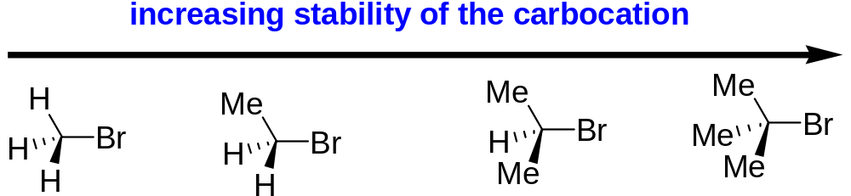
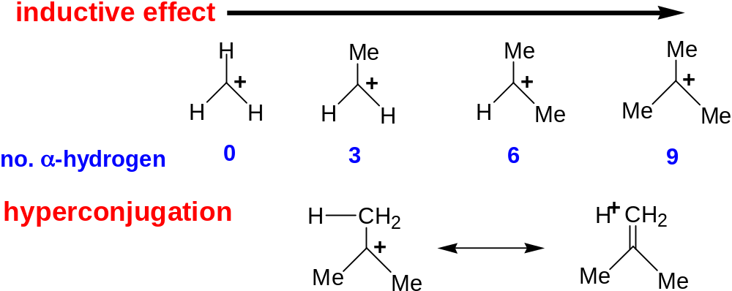
For S_{N}1 : ion pair formation
Stability of carbocation is important for S_{N}1

Slide 16
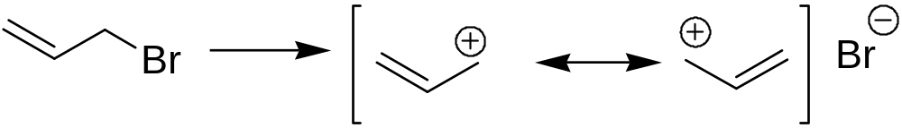
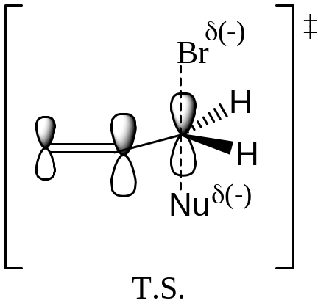
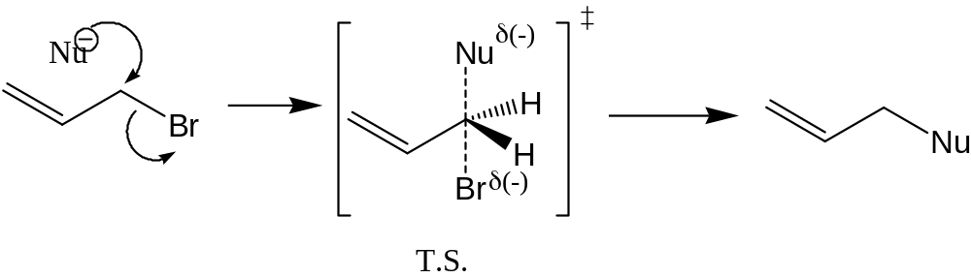
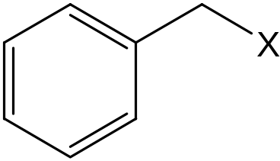
more reactive than
True for both S_{N}1 and S_{N}2
For S_{N}1: stabilisation of carbocation by delocalisation
For S_{N}2: stabilisation of TS by conjugation with allylic π-bond
The benzyl group acts in much the same way:

Slide 17
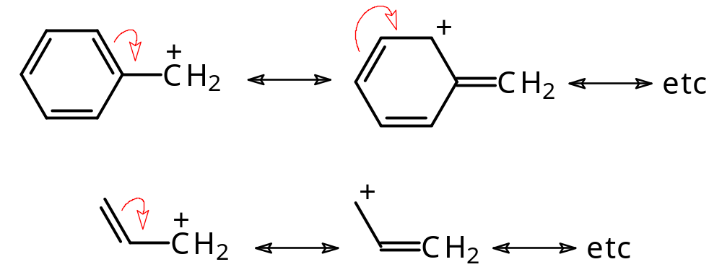
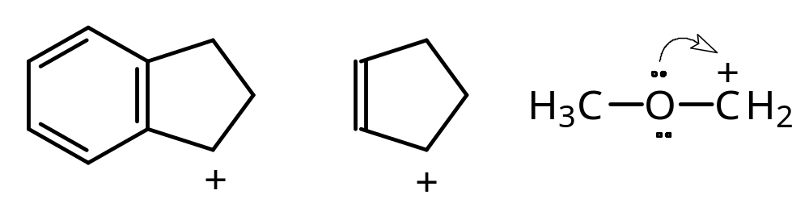
BENZYL AND ALLYL CARBOCATIONS
BENZYL
RESONANCE
STABILIZATION
ALLYL
Systems that are similar in form to benzyl and allyl are called benzylic and allylic.
isoelectronic
with allylic
(benzylic)
(allylic)

Slide 18
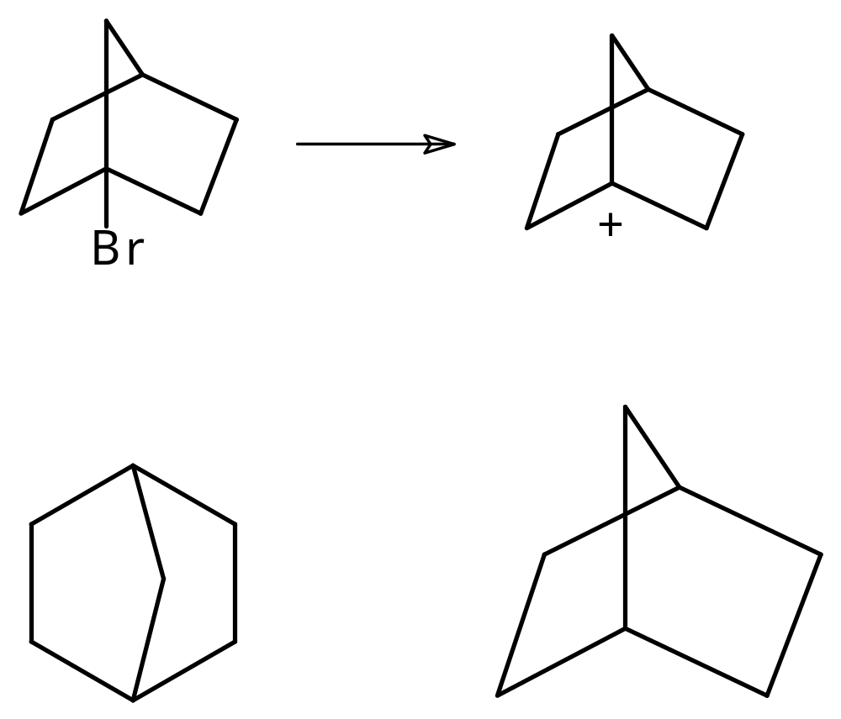
WILL NOT REACT - S_{N}1
X
+
cannot become
planar
+
“steric rigidity”

Slide 19
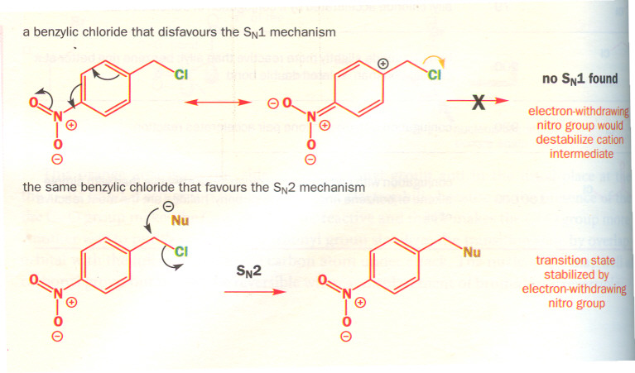

Slide 20
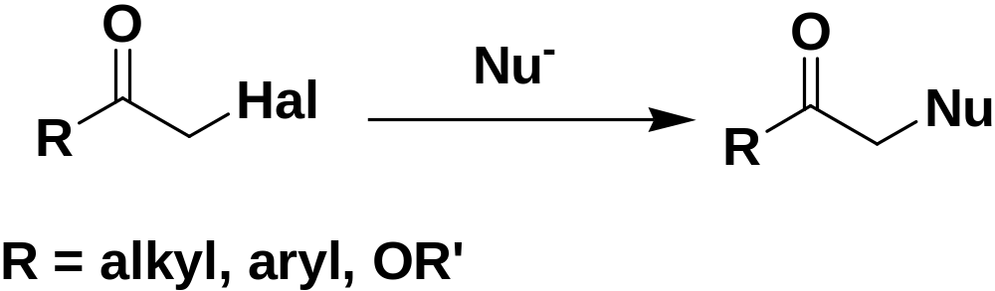
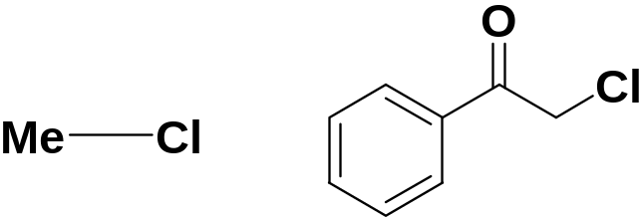
only S_{N}2, no S_{N}1
Relative rates of S_{N}2 reactions with iodide ion
1:500

Slide 21
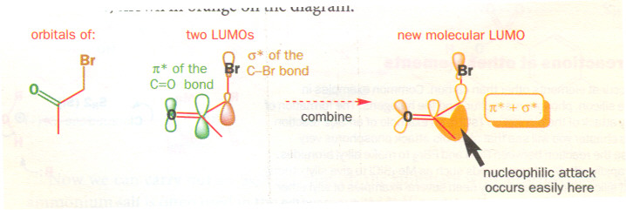

Slide 22
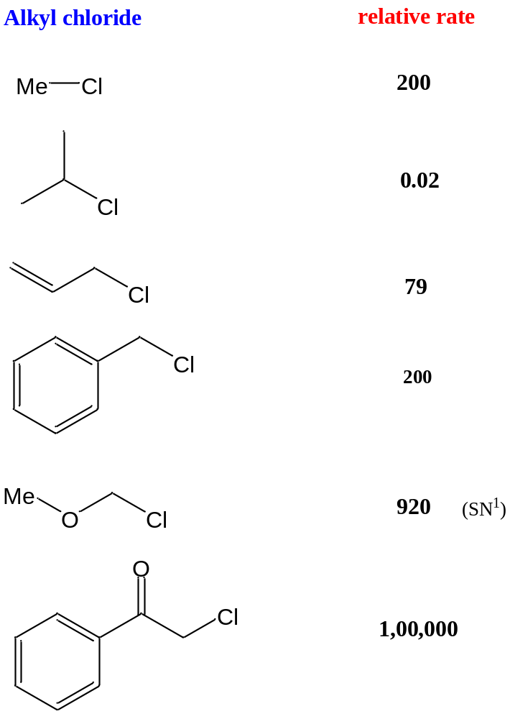
Relative rates of Substitution reactions of alkyl chlorides with the iodide ion
The rates are given with respect to
n-BuCl

Slide 23
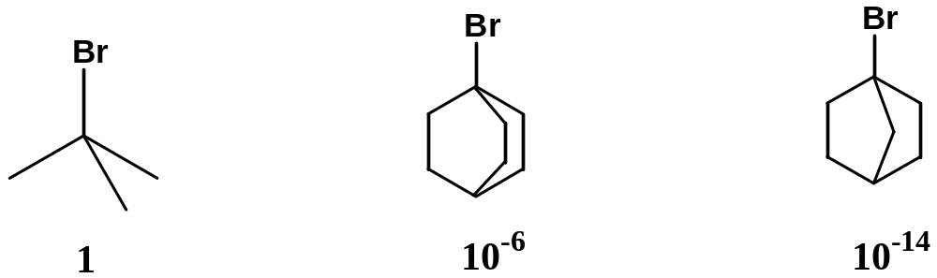
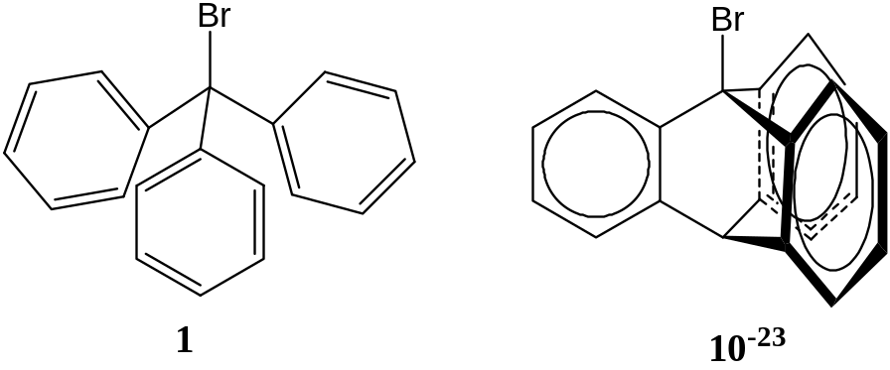
Problems :
1) S_{N}2 reaction by EtO⁻ in EtOH:
Explain ?
2) Rate of solvolysis in EtOH :
A)
Explain?
cc at bridge head, less stable, difficult to attain planarity due to rigidity
B)
Explain ?
A)
Rigid structure, cation empty p-orbitals are at right angles to π orbitals of Ph
1-bromotriptycene

Slide 24
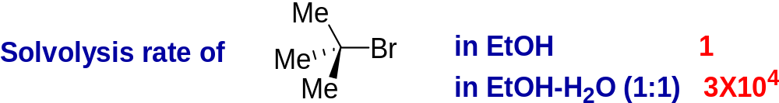
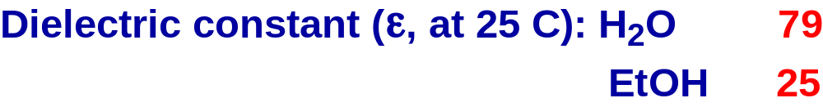
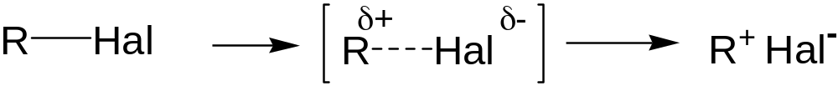
Solvent effect
Increase in dielectric constant and/or ion-solvating ability result in a marked increase in reaction rate
The energy required for this process decreases as dielectric constant increases
The process is facilitated by increasing solvation and consequent stabilization of the ion-pair

Slide 25
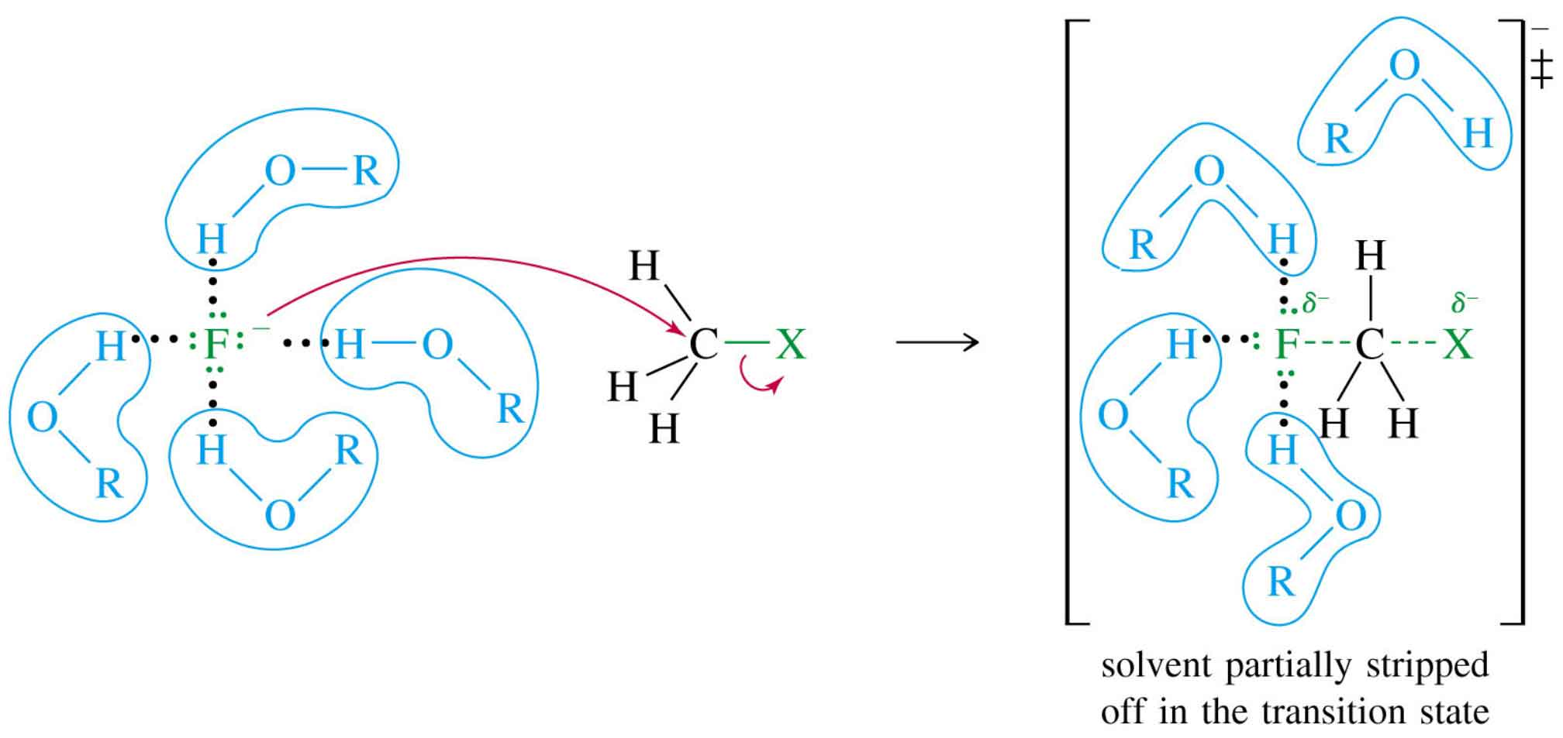
Solvent Effects (1)
Polar protic solvents (O-H or N-H) reduce the strength of the nucleophile. Hydrogen bonds must be broken before nucleophile can attack the carbon.
=>

Slide 26
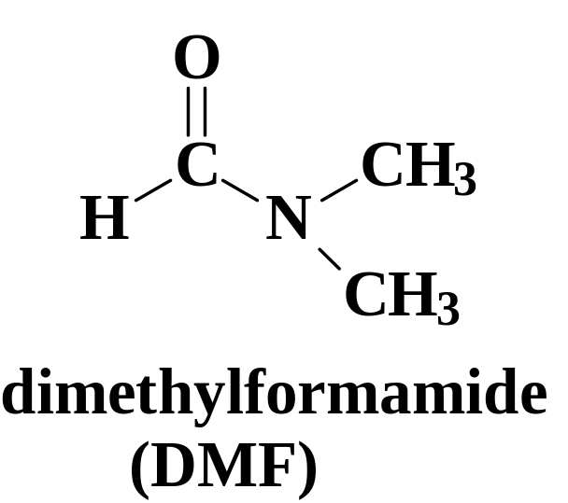
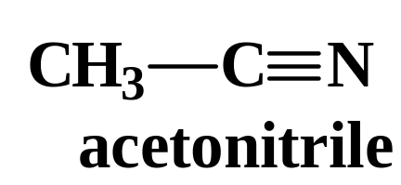
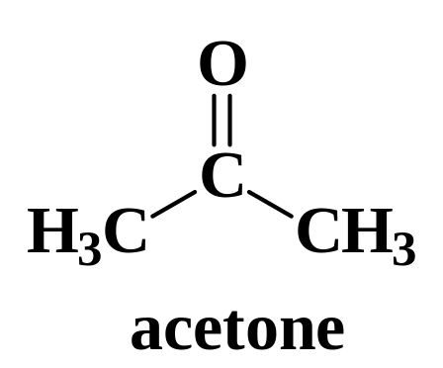
Solvent Effects (2)
Polar aprotic solvents (no O-H or N-H) do not form hydrogen bonds with nucleophile
Examples:
=>

Slide 27
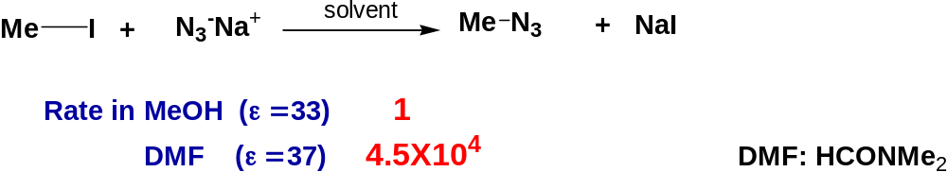
For S_{N}2: Increasing dielectric constant has much less effect.
Results in slight decrease in rate
New charge is not developed.
Existing charge is dispersed in the T.S. compared with the starting material
Marked effect on the rate of S_{N}2 reaction, when that transferred from polar protic solvent to polar aprotic solvent.
In MeOH both Na⁺ and N₃⁻ are solvated.
In DMF only Na⁺ is solvated, but not N₃^{-.}
So, unsolvated N₃⁻ is a much more powerful nucleophile

Slide 28
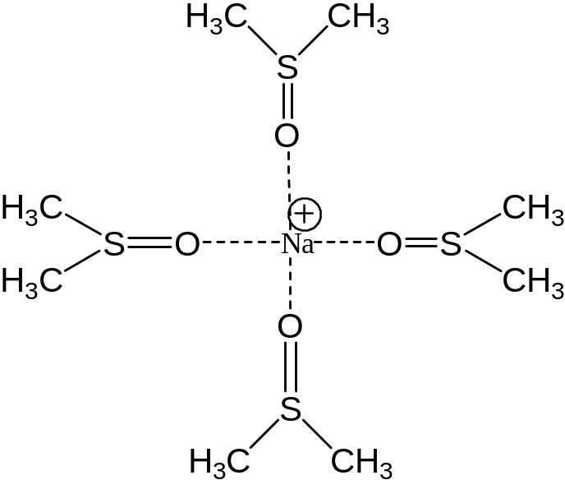
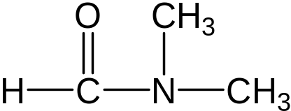



When RX is capable of undergoing both S_{N}1 and S_{N}2 reactions:
S_{N}2 reaction will be favored by a high concentration of a good (negatively charged) nucleophile in a polar aprotic solvent,
S_{N}1 reaction will be favored by a poor (neutral) nucleophile in a polar protic solvent
Polar aprotic solvents: DMF & DMSO
Polar protic solvents: H₂O, MeOH, EtOH
Increase in solvent polarity & ion-solvating ability may change the reaction mode from S_{N}2→S_{N}1
Transfer from polar, protic to polar, aprotic solvents can change the reaction mode from S_{N}1 → S_{N}2

Slide 29

S_{N}2: Nucleophilic Strength
Stronger nucleophiles react faster.
Strong bases are strong nucleophiles, but not all strong nucleophiles are basic.
=>

Slide 30




Nucleophilic power towards saturated carbon
In a particular group, nucleophilicity increases as we go down the group

Slide 31

Hard nucleophiles and Soft nucleophiles
Small with closely held electrons with high charge density | Large & Flabby with diffuse high energy electrons
Only charged | Can be neutral
Basic (HX weak acid) | Not basic (HY strong acid)
Low energy HOMO | High energy HOMO
Like to attack at C=O | Like to attack at saturated carbon
RO⁻, ⁻NH₂, R⁻, F⁻, Cl⁻ | RS⁻, I⁻,R₃P, RSH
Reactions are controlled by Electrostatic interactions | Reactions are controlled by HOMO-LUMO interactions

Slide 32
Functional group interconversion by substitution reaction at saturated carbon

Slide 33

TOSYLATES
ALCOHOL
+
p-TOLUENESULFONYL CHLORIDE
TsCl
+
TOSYL CHLORIDE
pyridine
ROTs
TOSYLATE ESTER

Slide 34



CONVERSION TO A TOSYLATE WITH TsCl AND PYRIDINE
Poor leaving
group
TsCl
..
..
+
*
:
-
Cl
..
R-OTs
pyridine
*
+
-
Good leaving group
for both S_{N}1 and S_{N}2
Cl
If the alcohol is
chiral, the conversion
to a tosylate retains
configuration.

Slide 35
EXAMPLE OF THE USE OF A TOSYLATE
(R)
(R)
TsCl
CH₃-CH-OH
CH₃-CH-OTs
pyridine
Ph
Ph
RETENTION
NaCN
acetone
S_{N}2
INVERSION
(S)
CH₃-CH-CN
Ph
Ph

Slide 36

EXPLANTION OF STEREOCHEMISTRY
Same configuration
as the starting alcohol.
..
:
pyridine
NaCN
The first reaction step
does not involve the
carbon stereocenter -
the atom oxygen reacts.
acetone
This step is an
S_{N}2 reaction
with inversion
of configuration.

Slide 37




Regioselectivity of epoxide opening
basic
Attack of powerful Nu
1,1,2-trisubstituted epoxide
Acid catalysis
Pure S_{N}2 Nu⁻ attacks at less substituted C-atom
Regeiochemistry reverses with conditions!!!
Opening happens at the more substituted end

Slide 38








A modern S_{N}2 reaction: Mitsunobu reaction
100% inversion
Mechanism:
First step involves neither the Nu nor the alcohol
Stable anion
Ph₃P=O
+

Slide 39


Problem:

Slide 40



Slide 41







Chemical Warfare
Mustard gas – a war gas
Alkylates DNA
causes severe blistering of the skin, respiratory problems, blindness, and death – nasty stuff
A liquid at room temperature but very volatile
Can persist in the environment for a very long time

Slide 42

Glutathione
This is the biological nucleophile that protects us from electrophiles that react with proteins and DNA:
Most
nucleophilic
site in an aqueous media
Highly
solvated
and not nucleophilic
The glutathione S_{N}2 product is highly polar and readily excreted.

